Slide 1

Module 6: Exploring Siebel SDE and SIL Mappings
0/5
Analytics: Data Warehouse Developer (Siebel 7.7)
Notes:
Time: Lecture: 40 – 50 minutes; labs: none
Intent: To become familiar with Source Dependent Extract and Source Independent Load mappings and sessions and how their common traits support ETL processing.
Flow: Define Extract and Load workflows; describe SDE and SIL sessions; provide overview of a typical SDE session; drill down on key sources, transformations, and targets of SDE sessions; provide overview of a typical SIL session; drill down on key sources, transformations, and targets of SIL sessions.
Key Terms:
Source Dependent Extract
Source Independent Load
Workflow
Session
Transformation
Source
Target
Unspecified
6

Slide 2
Module Objectives
After completing this module you will be able to:
  Describe the difference between Source Dependent Extract and Source Independent Load mappings
  Identify major transformations and their mechanics in Source Dependent Extract and Source Independent Load mappings
Why you need to know:
  To modify or extend the Informatica repository, you need to understand the mechanics of its mappings
Notes:
Each objective and “why you need to know” should be stated aloud.

Slide 3
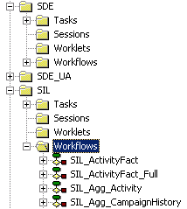
ETL Repository: Workflows
The Siebel Relationship Management Warehouse repository is organized into Source Dependent Extract (SDE) and Source Independent Load (SIL) workflows
SDE workflows
SIL workflows
Notes:
6.<number>
COMPANY CONFIDENTIAL AND PROPRIETARY INFORMATION—DUPLICATION IS PROHIBITED
Exploring Siebel SDE and SIL Mappings
This slide defines workflows, which organize the mapping sessions and are run from within Informatica Server Manager. Point out that they are organized by their function in the ETL process, extract, or load.
ETL workflows are discussed in detail in later module. The focus here is to explain the context of ETL workflows.
6

Slide 4
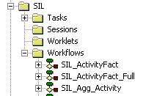
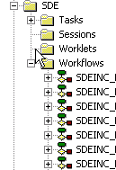
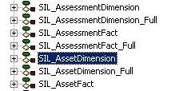

ETL Repository: Sessions
Workflows contain sessions, which specify mappings
Asset
Dimension-related SIL session
Asset
Dimension-related SDE session
Notes:
This slide introduces Source Dependent Extract and Source Independent Load sessions, which are contained in workflows. The sessions have a one-to-one relationship with their workflows so that they are discrete when called by the DAC Server. The graphic illustrates the parallelism between SDE and SIL sessions.
ETL sessions are discussed in detail in later module. The focus here is to explain the context of ETL sessions.

Slide 5
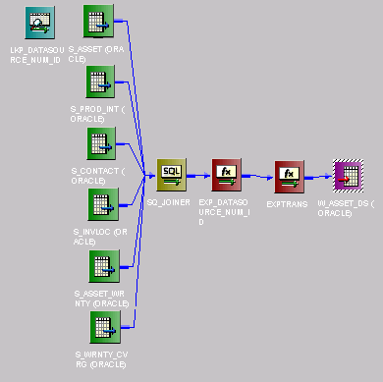
Anatomy of a Typical SDE Mapping
SDE mappings select from source Siebel transactional tables (S_*) and load warehouse staging tables (W_*_*S)
Transactional sources
Source Qualifier Transformation
Expression Transformation
Target table is the warehouse staging table
Notes:
6.<number>
COMPANY CONFIDENTIAL AND PROPRIETARY INFORMATION—DUPLICATION IS PROHIBITED
Exploring Siebel SDE and SIL Mappings
A mapping contains, among other things, source objects, transformations, and target objects, and is run as a session. This slide provides an overview of the function and major components of a typical SDE mapping or session. Note that each mapping may differ substantially from the examples provided in this and following slides, which examine a typical mapping.
Each of the highlighted elements in this slide is discussed in more depth subsequently, and the main point here is to illustrate the typical data flow in an SDE mapping.
The source objects of SDE mappings are Siebel transactional tables, whose data is retrieved, processed by the Source Qualifier transformation and other transformations, and loaded into an SRMW staging table, which is the typical target object of SDE mappings.
6

Slide 6
Anatomy of a Typical SDE Mapping Continued
A typical SDE mapping consists of the following transformation objects:
  Source Definition Transformation
    Represents source objects; varies by mapping
  Source Qualifier Transformation
    Is the core transformation common to all SDE mappings
    All functionality is pushed to the SQL in this transformation
    SQL syntax in this transformation is database-independent for out-of-the-box mappings
  Expression Transformation
    Used to calculate or modify values for rows
  Target Definition Transformation
    Represents target objects; varies by mapping
Notes:
6.<number>
COMPANY CONFIDENTIAL AND PROPRIETARY INFORMATION—DUPLICATION IS PROHIBITED
Exploring Siebel SDE and SIL Mappings
The Source Definition transformation object represents source objects.
The Source Qualifier transformation represents the row set retrieved from source objects before undergoing subsequent transformations. It is often used to perform the necessary data manipulation, which can include joining source objects, filtering rows, specifying custom joins such as outer join and inner joins, and data cleansing.
Expression transformation is used to calculate row values before results get written to target table or subjected to additional transformations.
The Target Definition transformation object represents target objects.

Slide 7
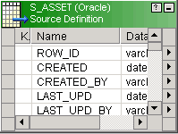
Source Definition Transformation
Represents source table objects
SDE mapping consists of one or more source table objects
Imported from database tables
Example: S_ASSET is the main source table in SDE_AssetDimension mapping
Notes:
6.<number>
COMPANY CONFIDENTIAL AND PROPRIETARY INFORMATION—DUPLICATION IS PROHIBITED
Exploring Siebel SDE and SIL Mappings
This slide highlights the Source Definition transformation of SDE mappings, which are Siebel transactional (OLTP) tables. Point out a typical mapping consists of one or more source tables.
6

Slide 8
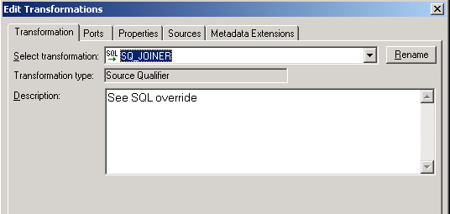
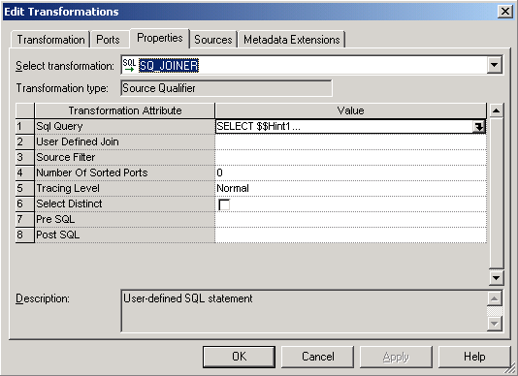
Source Qualifier Transformation
Represents data retrieved from source objects
SQL override is used to customize the SQL statement in the SQL query
Source Qualifier Transformation
SQL Override
Notes:
6.<number>
COMPANY CONFIDENTIAL AND PROPRIETARY INFORMATION—DUPLICATION IS PROHIBITED
Exploring Siebel SDE and SIL Mappings
This slide details Source Qualifier transformation object and how to edit SQL override option. The Source Qualifier provides the SQL override option to customize the default query.

Slide 9
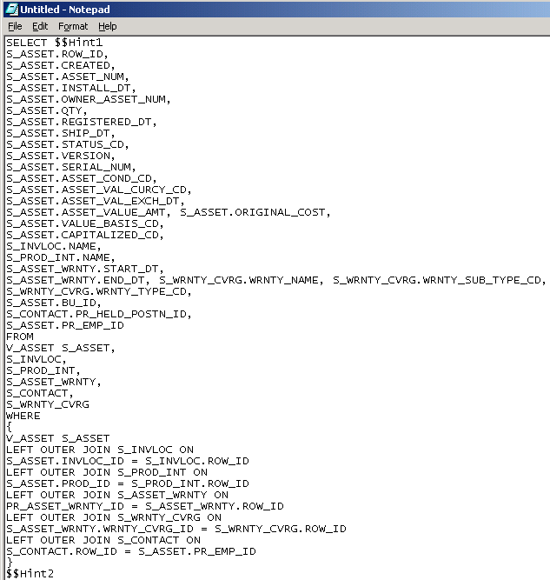
Source Qualifier Transformation Continued
Retrieves data
from transactional
tables based on a
database view (change capture view)
The change capture view is dynamically built for full and incremental loads for source tables
The change capture view name resembles source table name
  The prefix ‘S’ is replaced with ‘V’
  For example, V_ASSET for S_ASSET
Selects from the S_ASSET primary source table columns
Selects from a view on the primary source table, which joins source to its Incremental Image table
Also selects from secondary source tables
Notes:
6.<number>
COMPANY CONFIDENTIAL AND PROPRIETARY INFORMATION—DUPLICATION IS PROHIBITED
Exploring Siebel SDE and SIL Mappings
This slide details typical SQL query override processing, in which records from transactional sources are joined, selected and filtered.
The records are retrieved from a database (change capture) view instead of directly from the table for performance reasons. DAC dynamically creates this change capture view on OLTP for full and incremental loads for source tables. The change capture view definition for full load is different from that of incremental load.
DAC is discussed in detail in the later module (Module 9). The main point here is that records are retrieved from a database view instead of straight from the source table.
6

Slide 10
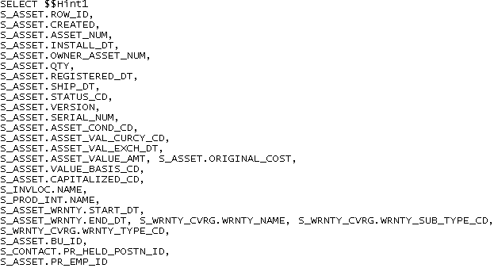
Source Qualifier Transformation Continued
Selects ROW_ID on primary source table
  Used as Integration ID for reference in warehouse tables
Selects List of Value (LOV) identifiers
Transactional table ROW_ID becomes Integration ID
LOV identifiers are extracted in SDE mappings, but are translated in the SIL mapping
Notes:
6.<number>
COMPANY CONFIDENTIAL AND PROPRIETARY INFORMATION—DUPLICATION IS PROHIBITED
Exploring Siebel SDE and SIL Mappings
The ROW_ID is mapped to INTEGRATION_ID in the warehouse which is used for reference to the row in the source table. List of Values (LOV) resolution is a good example of the work breakdown between SDE and SIL mappings. SDE selects and loads LOV identifiers into warehouse staging tables, from which they are then translated by SIL. This work breakdown allows selects to be performed on the source transactional tables, while isolating processing on the warehouse tables.

Slide 11
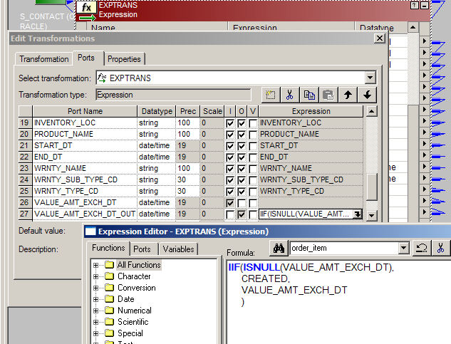
Expression Transformation
Expression transformations perform necessary processing on data retrieved by the Source Qualifier and other transformations
Example: Datasource Identifier calculation, AssetDimension-specific transformation
If value amount exchange date is null, use the create date, or else use value amount exchange date as provided (Informatica syntax)
Notes:
6.<number>
COMPANY CONFIDENTIAL AND PROPRIETARY INFORMATION—DUPLICATION IS PROHIBITED
Exploring Siebel SDE and SIL Mappings
Expression transformations vary in the processing they perform depending on the SDE mapping. Walk students through the example of the Asset dimension EXP_DATASOURCE_NUM_ID expression transformation, which specifies handling of Datasource Identifier.
6

Slide 12
Datasource Identifier
Represents the unique identifier of the source system
  For example, the value “1” is reserved for the Siebel transactional source
  In a multi-source environment, one would need to supply the datasource identifier
Is obtained as part of the SDE mapping process
DATASOURCE_NUM_ID field is a part of the unique user key in all fact and dimension tables of the warehouse
  For most tables, unique key consists of Datasource Identifier and Integration ID
Is calculated in Expression Transformation using:
  A reusable lookup transformation (LKP_DATASOURCE_NUM_ID) that looks up value in the W_PARAM_G internal table or
  Hard-coding the value “1”
Notes:
This slide provides details on the use and calculation of the datasource identifier. This is important in that the transformation appears in all SDE mappings, and the datasource identifier forms part of the unique key in the warehouse. It has to be stressed that DATASOURCE_NUM_ID value is set to “1” for Siebel transactional data. It is calculated either using a reusable transformation procedure or hard coding the value “1”.

Slide 13
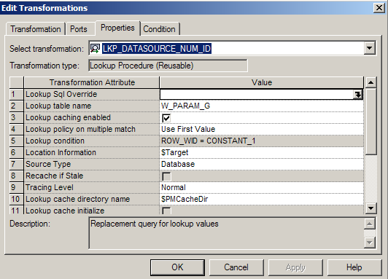
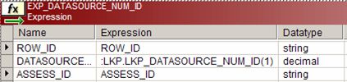
Datasource Identifier Processing
DATASOURCE_NUM_ID is retrieved by a lookup transformation and processed in an expression transformation
Reusable lookup transformation to retrieve datasource Num ID from the W_PARAM_G table
Expression transformation
Notes:
6.<number>
COMPANY CONFIDENTIAL AND PROPRIETARY INFORMATION—DUPLICATION IS PROHIBITED
Exploring Siebel SDE and SIL Mappings
DATASOURCE_NUM_ID calculation in Expression transformation appears in all SDE mappings.
6

Slide 14
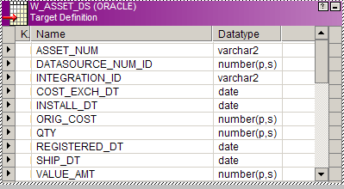
Target Definition Transformation
Represents target table objects
Imported from database tables
SDE mapping loads a staging table (W_*_*S)
Datasource Identifier and Integration ID are loaded into the staging table
  Used by SIL mapping to generate the surrogate key for warehouse
Notes:
6.<number>
COMPANY CONFIDENTIAL AND PROPRIETARY INFORMATION—DUPLICATION IS PROHIBITED
Exploring Siebel SDE and SIL Mappings
This slide highlights the Target Definition transformation of SDE mappings, which are warehouse staging tables. Point out the standard naming convention of staging tables.

Slide 15
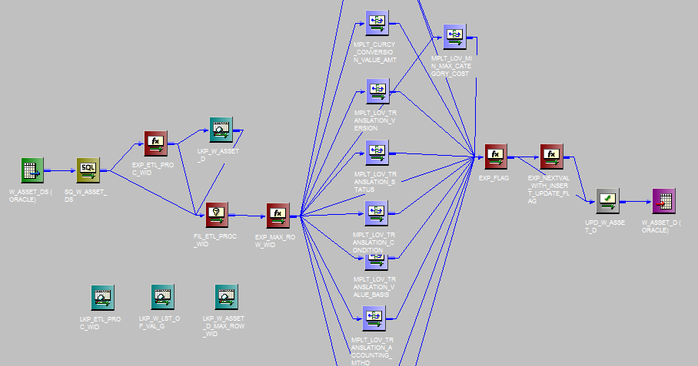
Anatomy of a Typical SIL Dimension Mapping
SIL mappings typically select from SRMW staging tables, perform transformations, and load warehouse tables
List of Value transformations
Staging table loaded by SDE is the SIL source table
Lookup table
Transformations
Target table is the warehouse fact or dimension table
Notes:
6.<number>
COMPANY CONFIDENTIAL AND PROPRIETARY INFORMATION—DUPLICATION IS PROHIBITED
Exploring Siebel SDE and SIL Mappings
This slide provides an overview of the function and major components of a typical SIL mapping or session. Note that each session may differ substantially from the examples provided in this and following slides, which examine a typical mapping.
Point out the differences from an SDE mapping with regards to source and target tables. SIL mappings are source-independent in that they do not select data from the transactional source, but rather from the warehouse staging tables, which are targets in SDE mappings. The targets of SIL mappings are the final warehouse tables.
6

Slide 16
Anatomy of a Typical SIL Dimension Mapping Continued
For each record inserted in SRMW, assigns ROW_WID
  Uniquely identifies a row in SRMW
  Generates unique value for new record
For each record inserted in SRMW, generates ETL_PROC_WID
  Uniquely identifies an ETL run
  Stored in W_PARAM_G table in the warehouse
List of Value translations are processed
  Language-Independent and Language-Dependent fields
Geography translations are processed
  Retrieves Geography ID based on country, city and postal code
Currency conversions are processed
  All amounts are converted to a single currency based on a currency conversion table—original values are retained
Reload is managed as part of the SIL mapping
Notes:
This slide presents an overview of the major processing performed by a SIL mapping. The ROW_WID is the unique identifier of a fact or dimension table. The ETL_PROC_WID is metadata about current and past ETL runs, and is used in managing ETL restarts. An example of LOV translation is provided in an upcoming slide. Currency conversions are necessary to perform analysis, for example, on revenue metrics with a single currency.

Slide 17
Anatomy of a Typical SIL Dimension Mapping Continued
Typical SIL mapping has the same transformation objects as an SDE mapping
In addition, may contain one or more of the following transformation objects:
  Filter Transformation
    Filters rows based on one or more condition
  Mapplet Transformation
    Allows to reuse a set of transformations in multiple mappings
  Reusable Transformations
    Allows to reuse a transformation logic in multiple mappings
  Lookup Transformation
    Looks up data in a source or target table
  Update Strategy Transformation
    Flags rows for insert, update, delete, or reject
Notes:
This slide presents an overview of the major components of a SIL mapping. In addition to some of the common transformations discussed in SDE mapping, this slide presents other transformation types in a typical SIL mapping. The details of each transformation type discussed in the following slides.
6

Slide 18
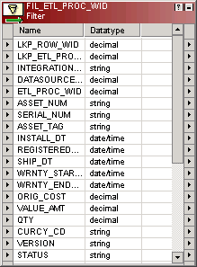
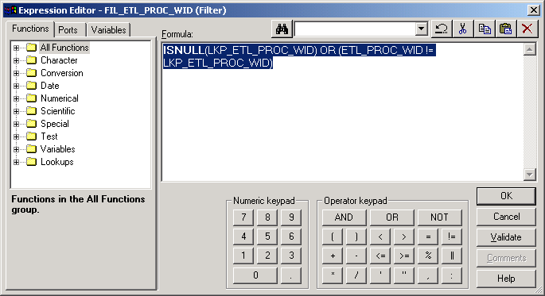
Filter Transformation
Filters out rows based on one or more condition
Part of an optimization mechanism
Example: FIL_ETL_PROC_WID Transformation.
  Filters out rows that have the same ETL_PROC_WID in the target table.
  Excludes any records that have already been processed
Filter Condition
Filter Transformation
Notes:
The filter transformation only allows rows meeting the filter condition. The rows that do not meet the filter criteria are not processed.

Slide 19
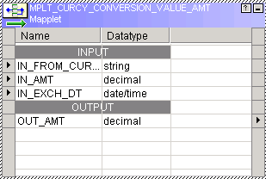
Mapplet Transformation
Reusable object that represents a set of transformations that can be used in multiple mappings
Contains built-in logic to receive inputs, handle exceptions, and output values
Example:
  MPLT_CURCY_CONVERSION_VALUE_AMT mapplet performs translations on currency based on exchange rate and date
Given an amount, currency code, and exchange date, it converts the amount to a currency amount defined as parameters in the W_PARAM_G and W_EXCH_RATE_G tables
Notes:
6.<number>
COMPANY CONFIDENTIAL AND PROPRIETARY INFORMATION—DUPLICATION IS PROHIBITED
Exploring Siebel SDE and SIL Mappings
Mapplets contain a set of transformations whose logic can be reused in multiple mappings. Siebel provides several prebuilt mapplets that can be readily used in custom mappings. Not all the mapplets are used in an SIL mapping. The SIL_AssetDimension mapping uses one such mapplet MPLT_CURCY_CONVERSION_VALUE_AMT to help with currency conversion process.
6

Slide 20
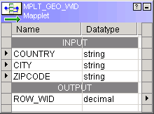
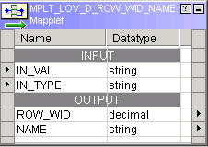
Mapplet Transformation Continued
MPLT_GEO_WID and MPLT_LOV_D_ROW_WID_NAME are the most commonly used mapplets in SIL mappings
These mapplets contain a series of lookup and other supporting transformations to retrieve dimension foreign keys for the fact tables
Given the Country, City and Zipcode, MPLT_GEO_WID mapplet retrieves the ROW_WID from Geography (W_GEO_D) dimension.
Given the LOV Value and Type, MPLT_LOV_D_ROW_WID_NAME retrieves the ROW_WID from List of Values (W_LOV_D) dimension.
Notes:
6.<number>
COMPANY CONFIDENTIAL AND PROPRIETARY INFORMATION—DUPLICATION IS PROHIBITED
Exploring Siebel SDE and SIL Mappings
The most commonly used mapplets in SIL mappings are MPLT_GEO_WID and MPLT_LOV_D_ROW_WID_NAME.
If students plan on attending the Analytics Case Study, point out that this reusable transformation will help them when configuring ETL mappings in the Case Study.
MPLT_GEO_WID mapplet receives Country, City, and Zipcode values as inputs and outputs the Geography dimension value.
MPLT_LOV_D_ROW_WID_NAME mapplet receives Value and Type values as inputs and outputs the List of Value (LOV) dimension value.
A mapplet can contain unused ports. Not all the input and output ports have to be connected in a mapping.

Slide 21
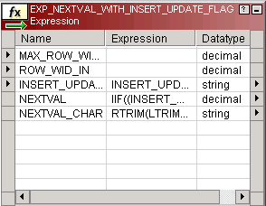
Reusable Transformation
There are many "out-of-the-box" reusable transformations that allow you to reuse a transformation logic in multiple mappings
Example:
  EXP_NEXTVAL_WITH_INSERT_UPDATE_FLAG Expression Transformation generates unique ROW_WID for new rows based on the:
    MAX_ROW_WID of the target table
    ROW_WID of the target table (in the case of an update)
    INSERT_UPDATE_FLAG
Notes:
6.<number>
COMPANY CONFIDENTIAL AND PROPRIETARY INFORMATION—DUPLICATION IS PROHIBITED
Exploring Siebel SDE and SIL Mappings
Siebel provides several standard reusable transformations to allow reuse of a transformation logic in multiple mappings. The SIL_AssetDimension mapping contains an Expression transformation EXP_NEXTVAL_WITH_INSERT_ UPDATE_FLAG to generate the Row ID based on the maximum Row ID currently stored in the target table.
Point out to the students that this reusable transformation is going to help them when configuring ETL mappings in the Case Study.
6

Slide 22
Lookup Transformation
A lookup transformation is used to look up data in a source or target table
There are two types of lookup transformations:
  Connected Lookup
  Unconnected Lookup
Notes:
6.<number>
COMPANY CONFIDENTIAL AND PROPRIETARY INFORMATION—DUPLICATION IS PROHIBITED
Exploring Siebel SDE and SIL Mappings
There can be more than one Lookup Transformation in a mapping. Connected and Unconnected Lookup transformations behave differently and have different purpose in a mapping. The two types of Lookup Transformations are discussed further in detail in the following slides.

Slide 23
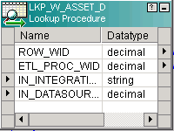
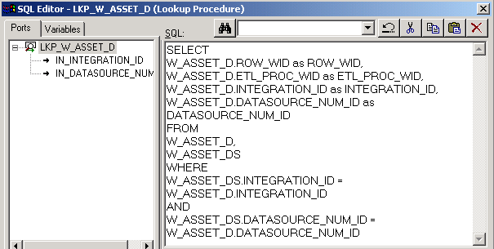
Lookup Transformation: Connected
Connected lookup transformation is part of the mapping flow
Example:
  LKP_W_ASSET_D queries the target table to determine which rows have the same Datasource ID and Integration ID as those in the staging table
  Rows with matching Datasource ID and Integration ID are updated
  Remaining rows are inserted in the target table
Filter Transformation
Lookup SQL Override
Notes:
6.<number>
COMPANY CONFIDENTIAL AND PROPRIETARY INFORMATION—DUPLICATION IS PROHIBITED
Exploring Siebel SDE and SIL Mappings
Connected Lookup transformation is part of the mapping flow. It is physically linked to transformation to receive inputs and provide outputs.
The LKP_W_ASSET_D lookup transformation in SIL_AssetDimension mapping looks up the target table W_ASSET_D to determine which rows have the same Datasource ID and Integration ID as those in the staging table W_ASSET_DS. This logic ensures that new rows are inserted and existing are not duplicated, but updated.
6

Slide 24
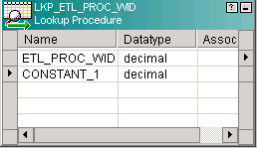
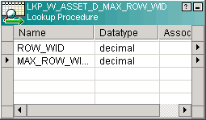
Lookup Transformation: Unconnected
Unconnected lookup transformation is a standalone lookup and not part of the mapping flow
Example:
  LKP_ETL_PROC_WID looks up the current ETL_PROC_WID stored in the W_PARAM_G process control table in SRMW.
  LKP_W_ASSET_MAX_ROW_WID lookups up the W_ASSET_D SRMW table to retrieve the max of ROW_WID
Notes:
6.<number>
COMPANY CONFIDENTIAL AND PROPRIETARY INFORMATION—DUPLICATION IS PROHIBITED
Exploring Siebel SDE and SIL Mappings
Unconnected Lookup transformation is a standalone transformation and not physically linked to other transformations in a mapping. The lookup transformation is called using :LKP expression. This kind of lookup transformation is very efficient for single value output.
The LKP_ETL_PROC_WID transformation in SIL_AssetDimension mapping is used to lookup and retrieve the ETL_PROC_WID stored in the W_PARAM_G table.
The LKP_W_ASSET_MAX_ROW_WID transformation in SIL_AssetDimension mapping is used to lookup and retrieve the max value of ROW_WID from the target table W_ASSET_D to generate unique ROW_WID values for new rows.

Slide 25
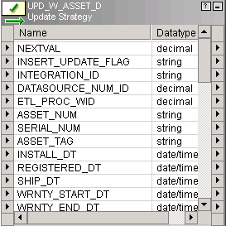
Update Strategy Transformation
Handles the update strategy for rows for insert, delete, update, or reject
Example:
  UPD_W_ASSET_D update strategy transformation inserts or updates a row based on the value of INSERT_UPDATE_FLAG
Notes:
6.<number>
COMPANY CONFIDENTIAL AND PROPRIETARY INFORMATION—DUPLICATION IS PROHIBITED
Exploring Siebel SDE and SIL Mappings
Update Strategy Transformation is used to decide how to handle changes to incoming rows—whether they should be inserted or updated.
The UPD_W_ASSET_D update strategy transformation in SIL_AssetDimension is instructed to decide whether a particular row should be updated or inserted based on the value of INSERT_UPDATE_FLAG. If INSERT_UPDATE_FLAG for a row is set to ‘INSERT’, the row is inserted, or else that row is updated.
6

Slide 26
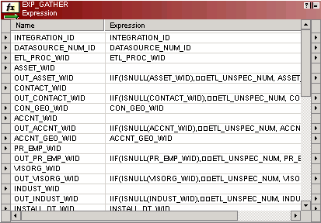
SIL Dimension and Fact Mappings: Differences
In Fact mappings, an expression transformation evaluates each value
  Null or unknown foreign key values are set to the UNSPECIFIED value of “0” on all ROW_WID columns
  Sets an insert/update flag
Notes:
The EXP_GATHER expression transformation is the main differentiator between fact and dimension loads. Recall that fact tables contain metrics and dimension tables contain attributes; therefore, nulls and unknown values are acceptable in dimensions but must be reset with a standard “unspecified” value for calculation in the fact.

Slide 27
Unspecified Sessions
All fact rows from source transactional tables that do not have a matching row in the respective dimension tables default to the UNSPECIFIED value
  All dimensions have a mapping that inserts one UNSPECIFIED row
  Default UNSPECIFIED values are obtained from W_LST_OF_VAL_G
Notes:
This slide discusses the role of the Unspecified sessions in maintaining referential integrity in the case that fact data has no corresponding data in a related dimension table. During load, each dimension is loaded with one UNSPECIFIED row, to which the fact table’s data is then related by the Unspecified session. Values for unspecified rows in the dimension tables are stored in the W_LST_OF_VAL_G internal table.
6

Slide 28
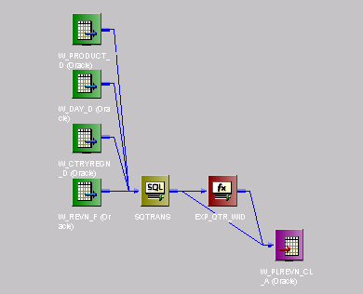
Aggregate SIL Mapping
Aggregate SIL mappings select from SRMW warehouse tables, perform aggregation, and load aggregate tables
Aggregations are handled by SQL Override in Source Qualifier
Target table is the aggregate fact table
Fact table is the main source table
Notes:
6.<number>
COMPANY CONFIDENTIAL AND PROPRIETARY INFORMATION—DUPLICATION IS PROHIBITED
Exploring Siebel SDE and SIL Mappings
This slide provides an overview of the function and major components of a typical aggregate SIL mapping. Aggregate SIL mappings are located in the same folder (SIL) where regular SIL mappings are located.
Point out the differences between a regular SIL mapping and aggregate SIL mapping. A regular SIL mapping selects data from warehouse staging tables, transforms the data, and populates the final warehouse tables. Whereas, an aggregate SIL mapping selects data from warehouse fact tables, sums up the facts, and populates the aggregate tables.
The aggregate tables are truncated and rebuilt every time the full ETL or incremental ETL is run.

Slide 29
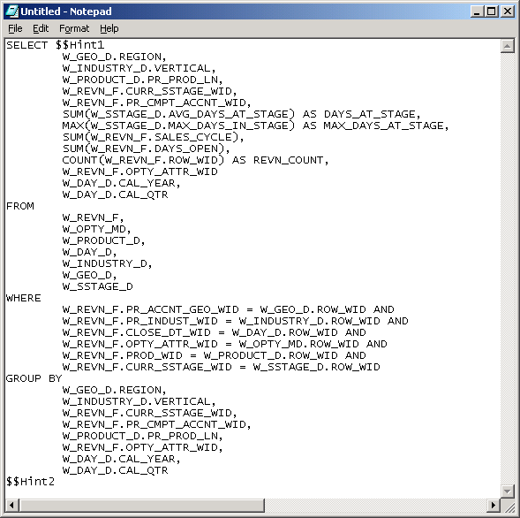
Aggregate SIL Mapping Continued
Retrieves data
from warehouse fact table in SRMW
Joins to dimension tables by which facts are aggregated
Groups by non-aggregated foreign key (WID) columns
Example:
  Revenue facts are aggregated by Quarter, Opportunity, Product, Industry, Geography and Stage dimensions
Performs
aggregation
Selects from the Revenue fact table
Notes:
6.<number>
COMPANY CONFIDENTIAL AND PROPRIETARY INFORMATION—DUPLICATION IS PROHIBITED
Exploring Siebel SDE and SIL Mappings
This slide details typical SQL query override processing for an aggregate SIL mapping, in which records from warehouse tables are selected, joined, and grouped.
The data grouping is pushed down to the database instead of aggregating in Informatica using an aggregator transformation for efficiency. The aggregate calculations can include sums, averages, counts, etc.
6

Slide 30
Summary
This module showed you how to:
  Describe the difference between Source Dependent Extract and Source Independent Load mappings
  Identify major transformations and their mechanics in Source Dependent Extract and Source Independent Load mappings
Notes:
This slide presents a summary of the topics covered in the module.
Review Questions:
Question: True or False. An SIL session selects from the Siebel transactional database and inserts into the Siebel Relationship Management Warehouse.
Answer: False. Source Independent Load session sources are typically warehouse staging tables that have been loaded by Source Dependent Extract sessions.
Question: What is a mapplet?
Answer: A mapplet contains a set of reusable transformation logic that can be used in multiple mappings.

